Slide 1
DS-306 Data Warehousing and Business Intelligence
Topic 3: Conceptual Data Warehouse Design
Dr. Khurram Shahzad

Slide 2
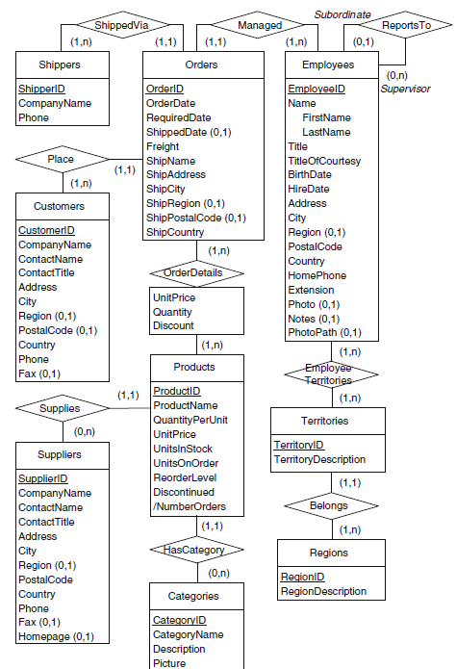
Northwind ERD

Slide 3
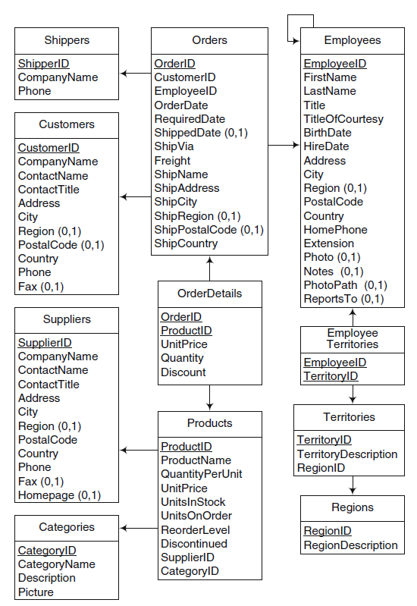
Northwind Logical

Slide 4
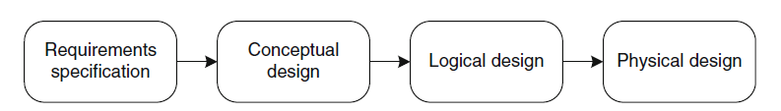
Data Warehouse Design Process

Slide 5
Dimensional Modeling
Dimensional Modeling focuses subject-orientation, critical factors of business
Critical factors are stored in facts
Redundancy is no problem, achieve efficiency

Slide 6
Dimensional Modeling
Two important concepts
  Fact
      Numeric measurements, represent business activity/event
      Are pre-computed, redundant
      Example: Profit, quantity sold

Slide 7
Dimensional Modeling
Two important concepts
  Dimension
      Qualifying characteristics, perspective to a fact
      Example: date (Date, month, quarter, year), product(type, category)

Slide 8
Dimensional Modeling
Every dimensional model (DM) is composed of one (or more) facts, and a set of dimensions.
Look on facts through one (or more) dimensions.
  What is the sale amount in Consumer Product category, for elderly customers in the second quarter of 2004?

Slide 9
Dimensional Modeling (Contd.)
Forms ‘star-like’ structure, which is called a star schema or star join
Dimensional Model has three types
  Star Schema
  Snowflake Schema
  Star-flake Schema

Slide 10
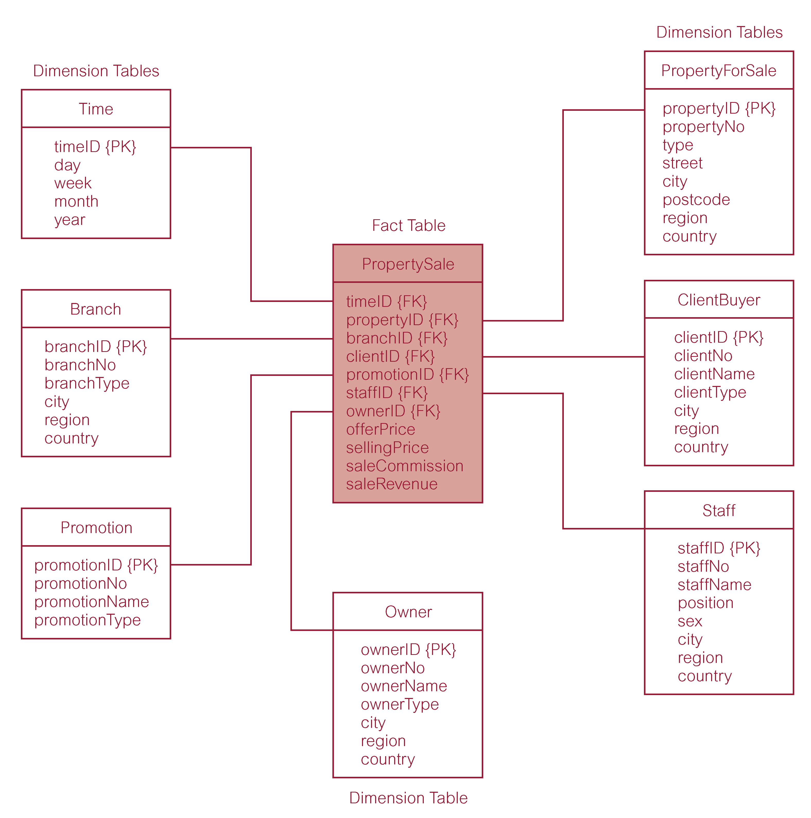
A Typical Dimensional Model

Slide 11
Example
TIME
time_key (PK)
SQL_date
day_of_week
month
PRODUCT
product_key (PK)
SKU
description
brand
category
FACT
time_key (FK)
store_key (FK)
clerk_key (FK)
product_key (FK)
customer_key (FK)
promotion_key (FK)
dollars_sold
units_sold
dollars_cost
STORE
store_key (PK)
store_ID
store_name
address
district
floor_type
CUSTOMER
customer_key (PK)
customer_name
purchase_profile
credit_profile
address
CLERK
clerk_key (PK)
clerk_id
clerk_name
clerk_grade
PROMOTION
promotion_key (PK)
promotion_name
price_type
ad_type

Slide 12
Conceptual Model

Slide 13
Conceptual modeling: MultiDim Model
Remember, A star schema is composed of a set of dimensions and a set of facts
The conceptual model of DW is called MultiDim Model

Slide 14
Notation of MultiDim Model
Level
Hierarchy
Cardinalities
Fact with measures and associate levels
Types of measures
Hierarchy name
Exclusive relationships

Slide 15
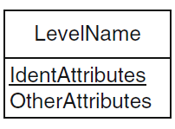
Notation of MultiDim Model
Level
  Level is analogous to an entity type in the ER model
  Level has a set of attributes
  Level has identifiers that uniquely identifies the members of a level
  Instances of a level are called members

Slide 16
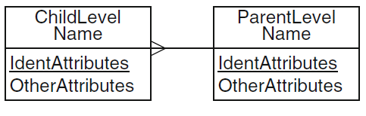
Notation of MultiDim Model
Hierarchy
  Product and Category

Slide 17
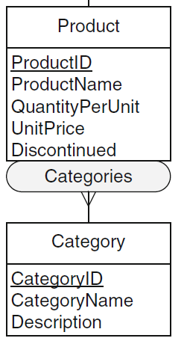
Example

Slide 18
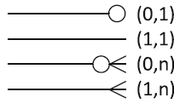
Notation of MultiDim Model
Cardinalities
  Indicates the minimum and maximum number of fact members that can be related to level member
  Sales fact is related to Product with one-to-many

Slide 19
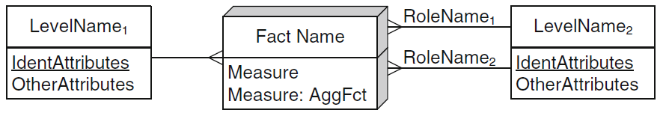
Notation of MultiDim Model
A fact may contain attributes commonly called measures
Fact with measures and associated levels
  Sales fact can include, measures, quantity, unit process, discount, sales amount, net-amount

Slide 20
Types of Measures
Additive measure
  Meaningfully summarized along all the dimensions, using addition e.g. quantity
Semiadditive measures
  Can be meanfully summarized using addition along some, but not all, dimensions e.g. inventory quantity

Slide 21
Types of Measures
Nonadditive measures
  That cannot be meaningfully summarized using addition across dimensions e.g. price, cost per unit, exchange rate
Derived
  Measures can be derived. That is, they are calculated on the basis of other measures

Slide 22
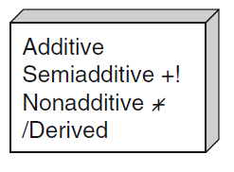
Notation of MultiDim Model
Types of measures

Slide 23

Notation of MultiDim Model
Hierarchy name
  Hierarchy comprises of several related levels
  Lower level is called child, and higher is called parent

Slide 24

Notation of MultiDim Model
Exclusive relationships
  States can be aggregated into regions
  States can be aggregated into countries

Slide 25
Northwind ERD

Slide 26
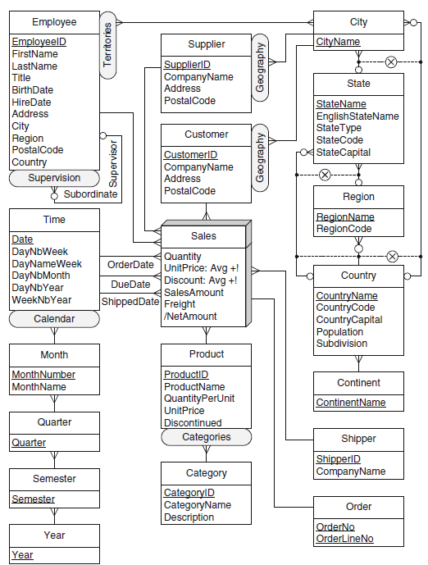
Northwind DM

Slide 27
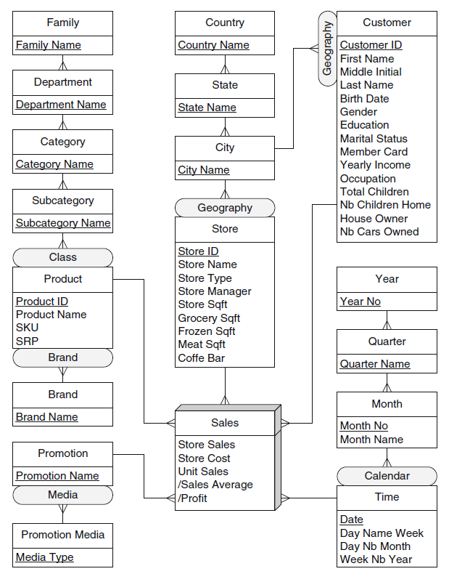
Foodmart DW

Slide 28
Foundations of Conceptual Modeling

Slide 29
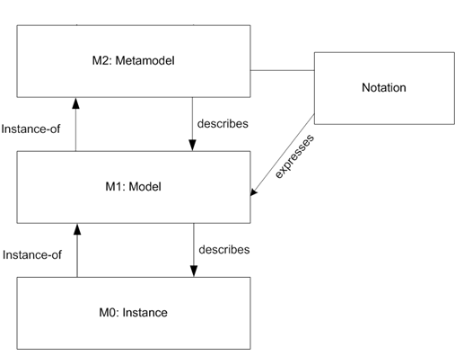
What is Metamodel?
A model that contains
  All the modeling concepts
  All possible relationships between the concepts
Levels in modelling

Slide 30
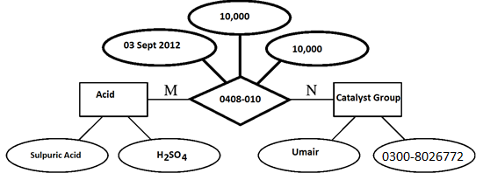
Abstraction concepts ERD
Instance level reflects the concrete entities that are involved in business processes
  At this level, executed activities, concrete data values, and resources & person are represented
  Examples of instances

Slide 31
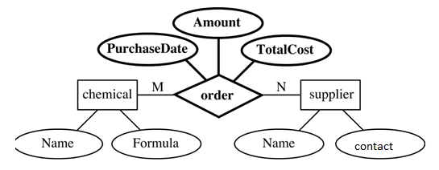
Abstraction concepts
To organize complexity of process scenarios, a set of similar entities at instance level are identified and classified at model level
  A set of similar process instances are classified and represented by a process
  Examples of model level

Slide 32
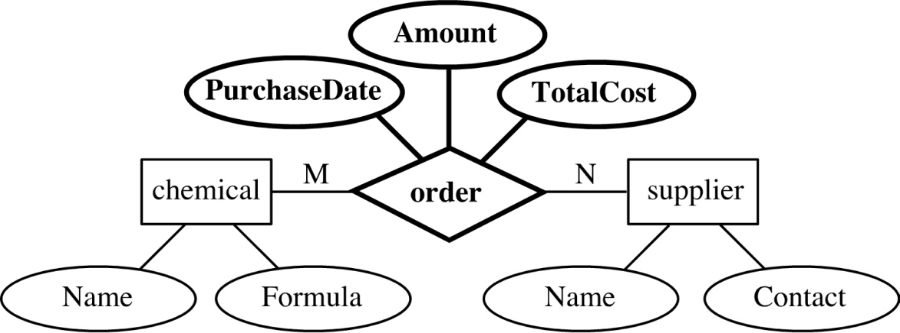
Abstraction concepts

Slide 33
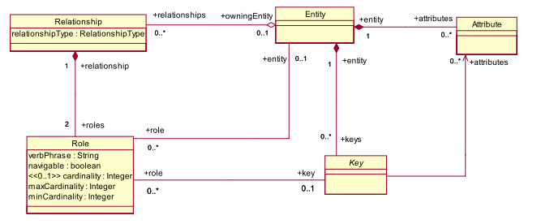
Abstraction concepts
The complete set of concepts and associations between concepts is called metamodel
  Example

Slide 34

(Horizontal) Abstraction concepts

Slide 35
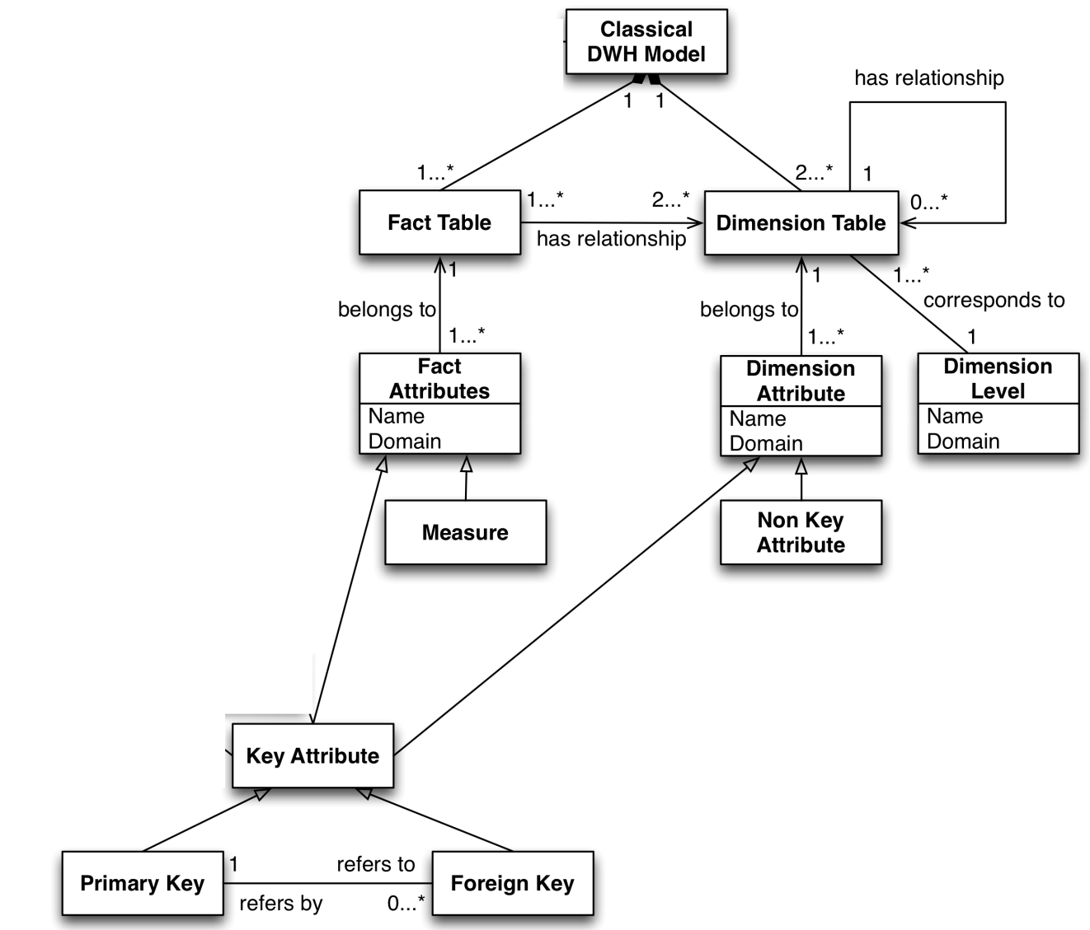
Meta model for DW

Slide 36
Dimensional Hierarchies

Slide 37
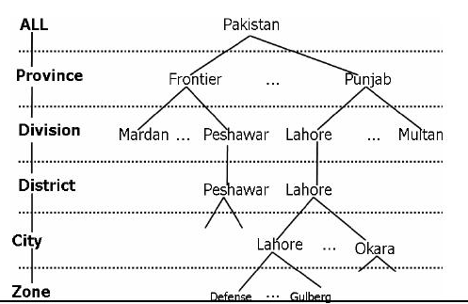
Dimensional Hierarchies
Dimensions have hierarchies
  Model level representation of dimension
  Instance level representation of dimension

Slide 38
Dimensional Hierarchies
Types of dimensional hierarchies
  Balanced Hierarchies
  Unbalanced Hierarchies
  Generalized Hierarchies
  Alternative Hierarchies
  Parallel Hierarchies
  Nonstrict Hierarchies

Slide 39
Balanced Hierarchies
Balanced Hierarchy
  A balanced hierarchy has only one path where al the levels are mandatory
  All the branches have the same length
  All parent members have at least one child members
  A child member belongs exactly to one parent member

Slide 40
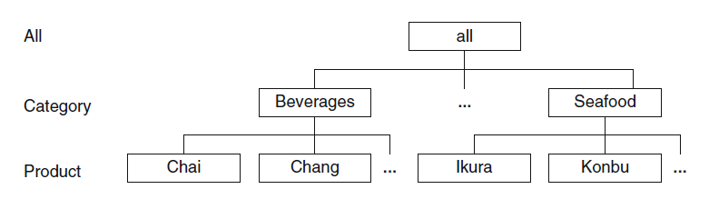
Balanced Hierarchies
Balanced Hierarchy (instance level)

Slide 41
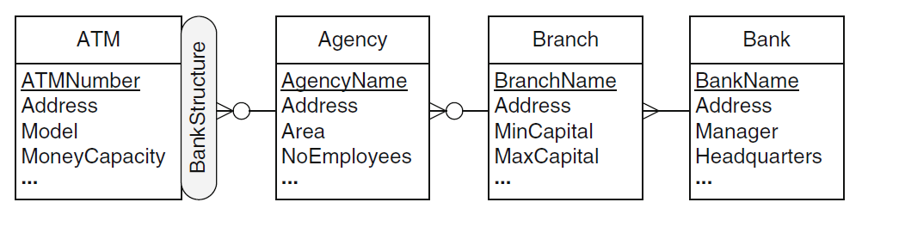
Unbalanced Hierarchies
Unbalanced Hierarchy (model level)
  Unbalanced hierarchy has only one path where at least one level is not mandatory
  Therefore, at the instance level, there can be parent members without associated child members

Slide 42
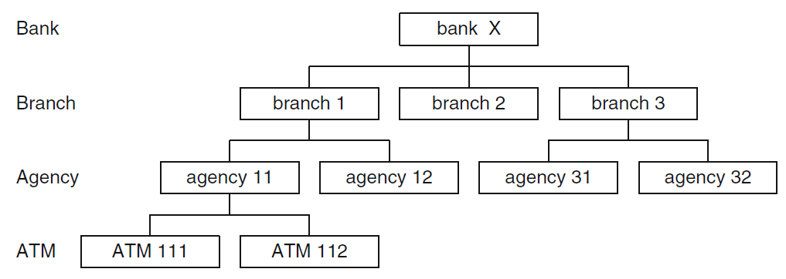
Unbalanced Hierarchies (Instance level)

Slide 43
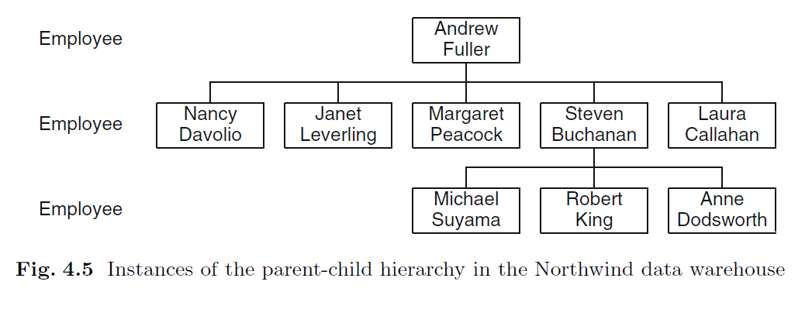
Unbalanced Hierarchies

Slide 44
Generalized Hierarchies
Hierarchies can be of different types
  Customer can be a company or a person
Suppose measures pertaining to customer must be aggregated differently
  Customer → Sector → Branch
  Customer → Profession → Branch
Such hierarchies are called generalized hierarchies

Slide 45
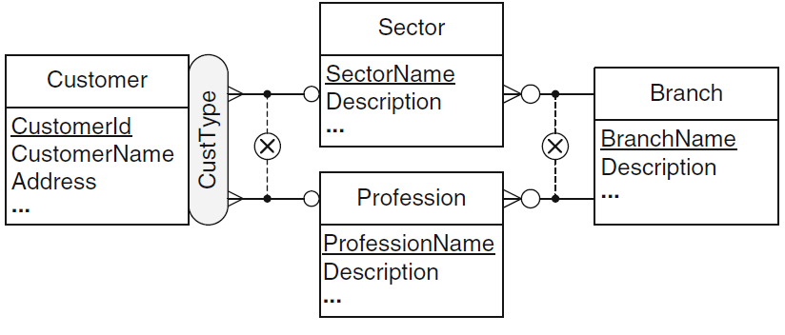
Generalized Hierarchies
The rounded symbol of exclusivity indicates that paths are exclusive for every member
  The levels at which alternative paths split and join are called, the splitting and joining levels

Slide 46
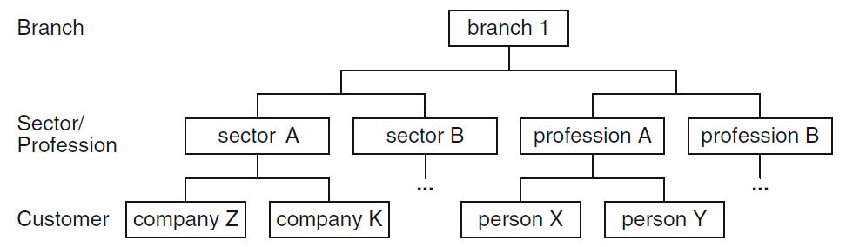
Generalized Hierarchies

Slide 47
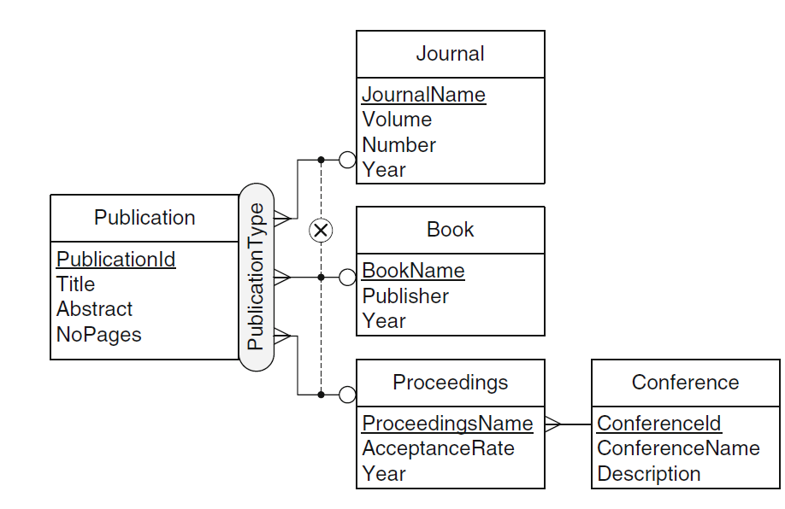
Generalized Hierarchies
Example generalized hierarchy without joining level

Slide 48
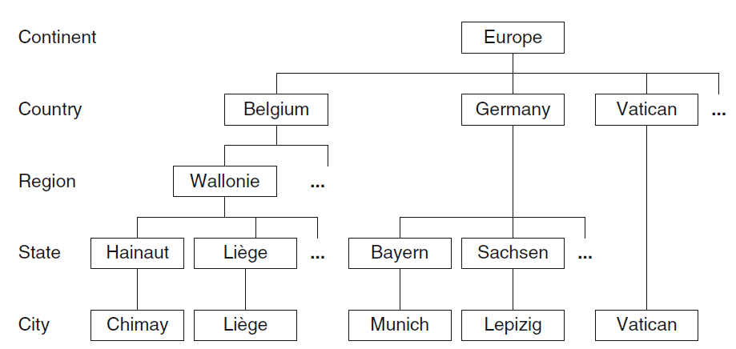
Generalized Hierarchies
Generalized hierarchies include a special case, ragged hierarchies
  Some countries, such as Belgium, are divided into regions, such as Germany, are not

Slide 49
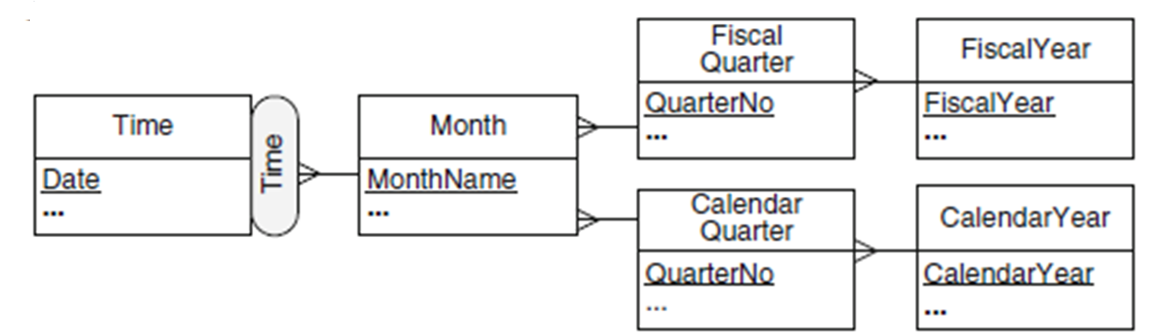
Alternative Hierarchy
Represents the situation where there are several nonexclusive hierarchies that share at least the leaf level

Slide 50
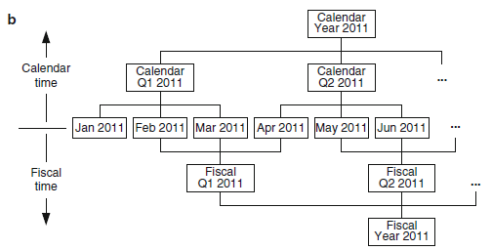
Alternative Hierarchy

Slide 51
Parallel hierarchies
Two types of parallel hierarchies depending upon the whether they share level
  Dependent parallel hierarchies
  Independent parallel hierarchies

Slide 52
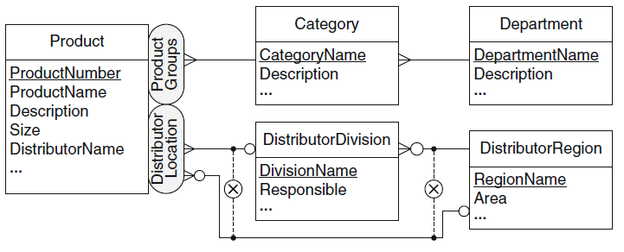
Parallel Independent hierarchies
Dimensions have two independent hierarchies

Slide 53
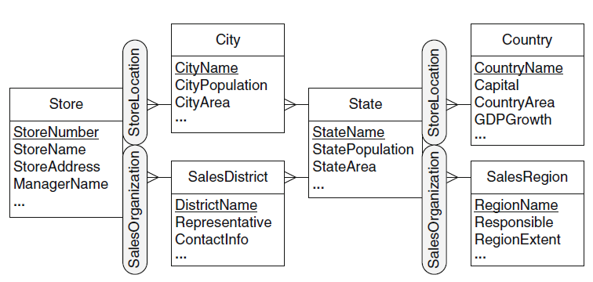
Parallel Dependent hierarchies
Hierarchy levels are dependent on each other

Slide 54
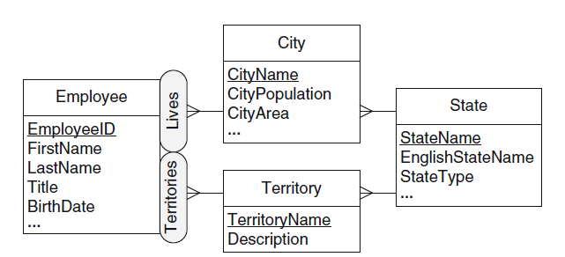
Parallel Dependent hierarchies
Parallel dependent hierarchies leading to different parent members of shared level

Slide 55
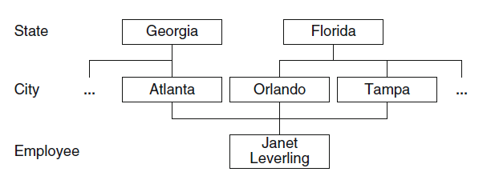
Nonstrict Hierarchies
Many-to-many relationship between parent and child level are common in real life
A hierarchy that has at least one many-to-many relationship is called nonstrict
  Otherwise, it is called strict hierarchy

Slide 56
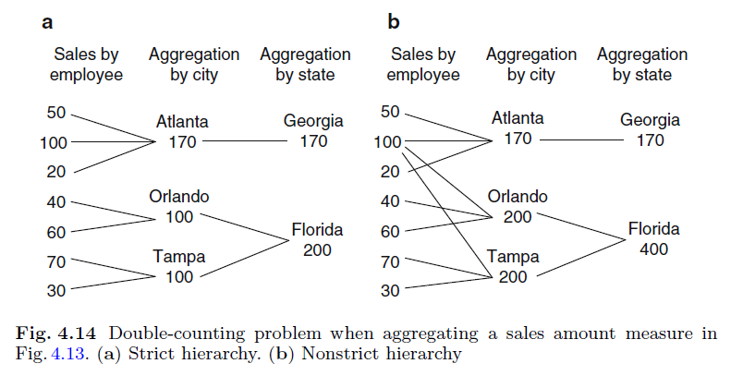
Strict vs Nonstrict Hierarchies

Slide 57
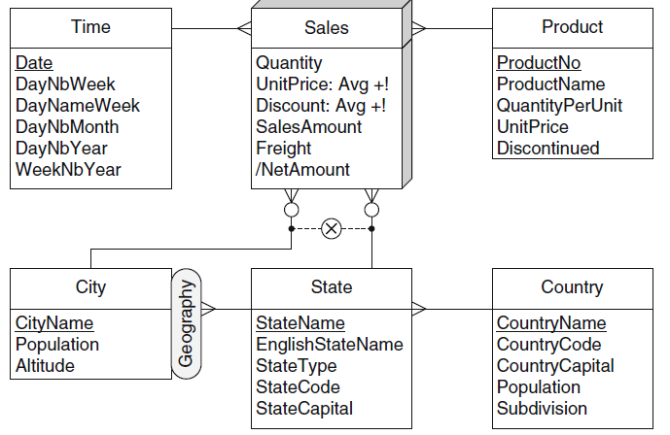
Multiple granularities for the sales fact

Slide 58
Multiple granularities for the sales fact

Slide 59
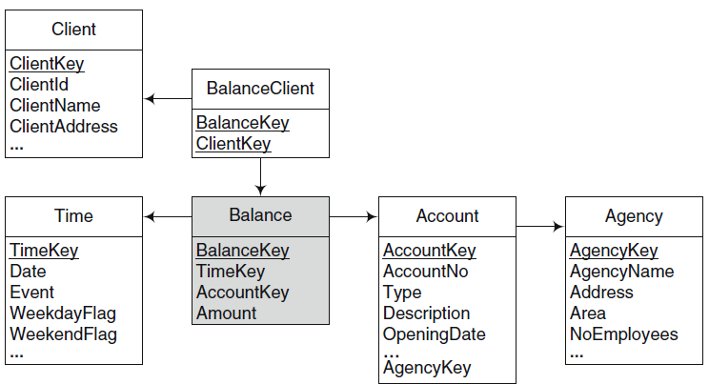
Many-to-Many Dimensions

